Slide 1

Green Pace
Security Policy Presentation
Developer: Nicholas Boodoo
SNHU CS 405

Slide 2

OVERVIEW: DEFENSE IN DEPTH
Defense in Depth (DiD) multi-layer defense system illustration.

Slide 3
THREATS MATRIX
Likely Threats that have more frequency to occur | Priority Standards with higher relevance
Low priority Standards with lower relevance | Unlikely Threats that have more frequency to occur

Slide 4
10 PRINCIPLES
Validate Input Data
Heed Compiler Warnings
Architect and Design for Security Policies
Keep It Simple
Default Deny
Adhere to the Principle of Least Privilege
Sanitize Data Sent to Other Systems
Practice Defense in Depth
Use Effective Quality Assurance Techniques
Adopt a Secure Coding Standard

Slide 5
CODING STANDARDS
STD – 003: Guarantee that storage for strings has sufficient space for character data and the null terminator
STD – 004: Do not store an already-owned pointer value in an unrelated smart pointer
STD – 005: Properly deallocate dynamically allocated resources
STD – 009: Do not attempt to create a std::string from a null pointer
STD – 010: Do not define a C-style variadic function
STD – 007: Guarantee exception safety
STD – 001: Do not cast to an out-of-range enumeration value
STD – 002: Use valid references, pointers, and iterators to reference elements of a container
STD – 008: Range check element access
STD – 006: Use a static assertion to test the value of a constant expression
Rule | Severity | Likelihood | Remediation Cost | Priority | Level
STD-001-CPP | Medium | Unlikely | Medium | Low | 2
STD-002-CPP | High | Probable | High | Medium | 2
STD-003-CPP | High | Likely | Medium | High | 5
STD-004-CPP | High | Likely | Medium | High | 5
STD-005-CPP | High | Likely | Medium | High | 5
STD-006-CPP | Low | Unlikely | High | Low | 1
STD-007-CPP | High | Likely | High | Medium | 3
STD-008-CPP | High | Unlikely | Medium | Medium | 2
STD-009-CPP | High | Likely | Medium | High | 5
STD-010-CPP | High | Probable | Medium | High | 4

Slide 6
ENCRYPTION POLICIES
Encryption
Flight - An encryption at flight is when data is encrypted while being transmitted. These encryptions are helpful when employees and/or users are allowed to telecommute or mobile work from the office.
At Rest - An encryption in rest is when data is encrypted while it is being stored. The data is accessible, but the encryption prevents the data from being readable without a proper key.
In Use - An encryption in use is when data is encrypted while being used and gives certain users certain access to the data depending on an employee’s security level. This encryption protects the business or government’s databases by creating layers of security to separate user activity from employees.

Slide 7
TRIPLE-A POLICIES
Policies
Authentication – employs the use of user logins, passcodes, possible secure networks, and other security features such as fingerprint scanning and two-feature identification depending on the security level for certain users.
Authorization – allows user access if they are authenticated. There are multiple levels of authorization with the administrator being the highest.
Accounting - Keep records on when data has been changed in a system and who made these changes. There are also certain systems that require a user to make a comment explaining why a user made certain changes to a system.

Slide 8
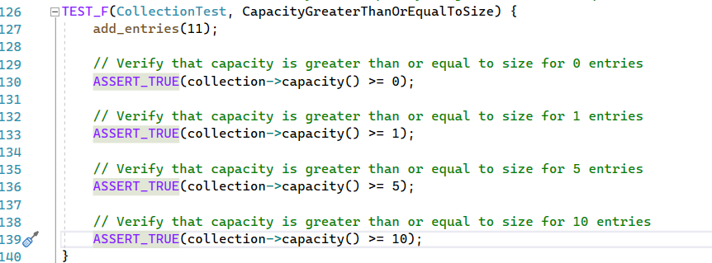
Unit Testing #1: Is Capacity Greater than or Equal to size for entries?

Slide 9
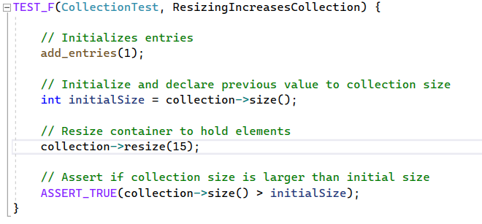
Unit Testing #2: Does resizing increase collection?

Slide 10
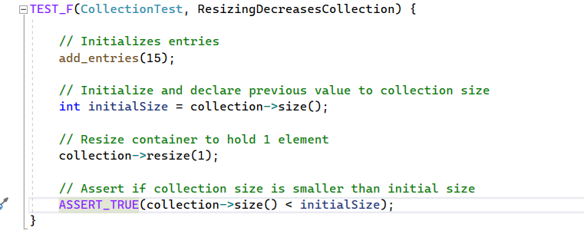
Unit Testing #3: Does resizing decrease collection?

Slide 11
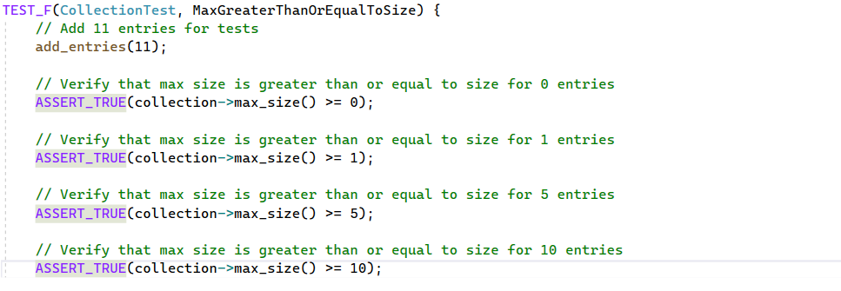
Unit Testing #4: Is max size greater than or equal for entries?

Slide 12

AUTOMATION SUMMARY

Slide 13
TOOLS
DevSecOps pipeline - Integrating security into the software development life cycle.
Tools – External tools such as cppchecker and IDEs are used to discover warnings, errors, and messages when developed code is being executed. Compiler warnings are a very useful part of an IDE.

Slide 14
RISKS AND BENEFITS
Now
Risks – Time is being used on multiple tests
Benefits – The project will be much more secure
Wait
Risks – Areas of code not compatible with security features, unsecure code during development, delays in product shipment
Benefits – Able to focus on important parts of code as soon as possible.

Slide 15
RECOMMENDATIONS
Security development during life cycle
Plan out security before the development begins and execute the security procedures throughout the project
Developers
Work as a team to prioritize security
No one developer should be doing all the work
Security team vs coding team
Triple A
Utilize encryption systems
Encryption types

Slide 16
CONCLUSIONS
It is very important to develop secure code. Protecting against data breaches is of the utmost importance since a lot of companies will be dealing with customer's data. The information of the public should be kept secure at all costs.

Slide 17
REFERENCES
Defense in Depth | CISA. (n.d.). Retrieved October 16, 2022, from https://www.cisa.gov/uscert/bsi/articles/knowledge/principles/defense-in-depth

